Slide 1


LensEd
The Front-End Collective – Full Stack Final Project Jan 2025 Bootcamp

Slide 2



LensEd
LensEd is a photography e-learning website/portal to provide educational resources and training to photography enthusiasts. Users can sign up, log in, and view details of available courses.
“Welcome to E-Learning Photography! Master the art of capturing stunning moments through our expert-led courses, interactive lessons, and inspiring projects”

Slide 3
Team
Sireesha
Main focus on back-end coding, but also some work on front end and linking, GitHub set up
Darren
Main focus on front end coding, but also some linking of front to back end, especially sign up
Pip
Auxiliary tasks including README, presentation design and some minor coding on the courses page

Slide 4

Wireframe and Planning
LensEd – The Front-End Collective

Slide 5

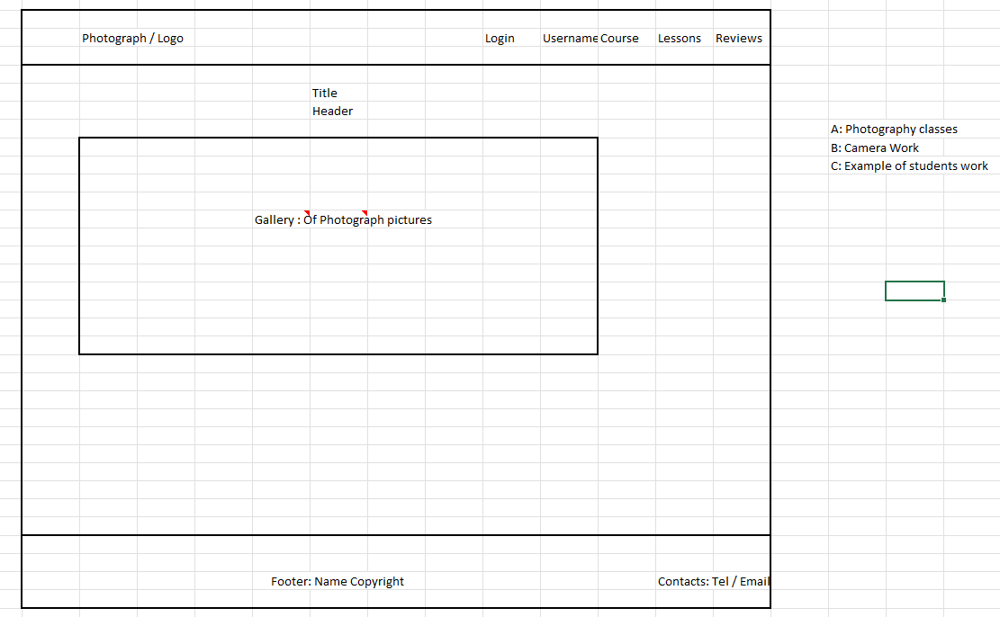
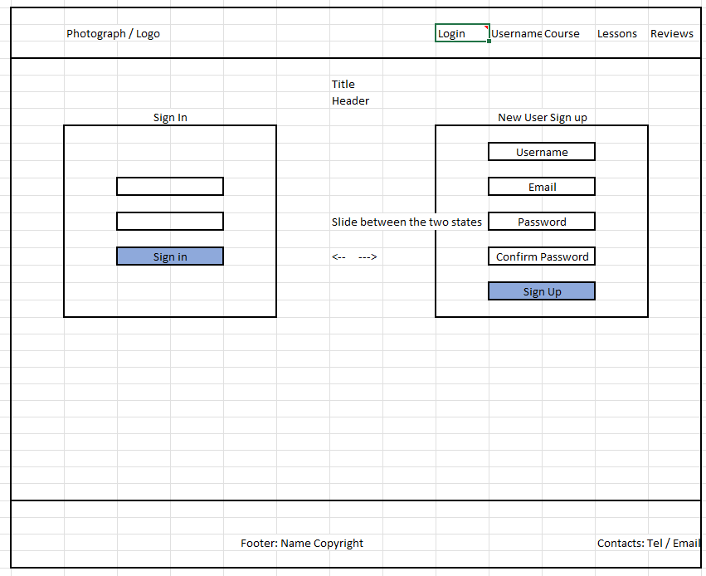
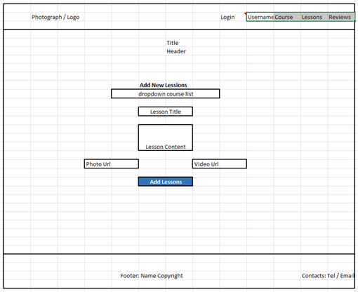
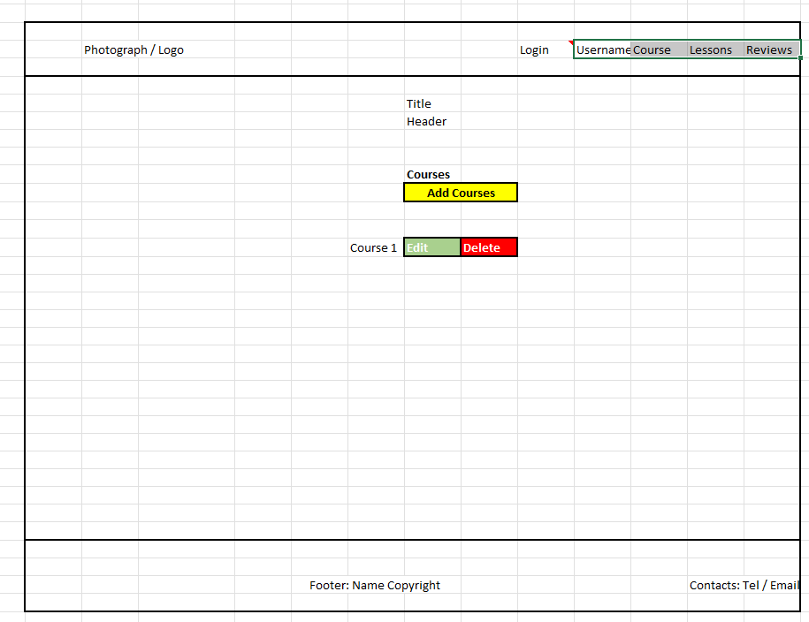
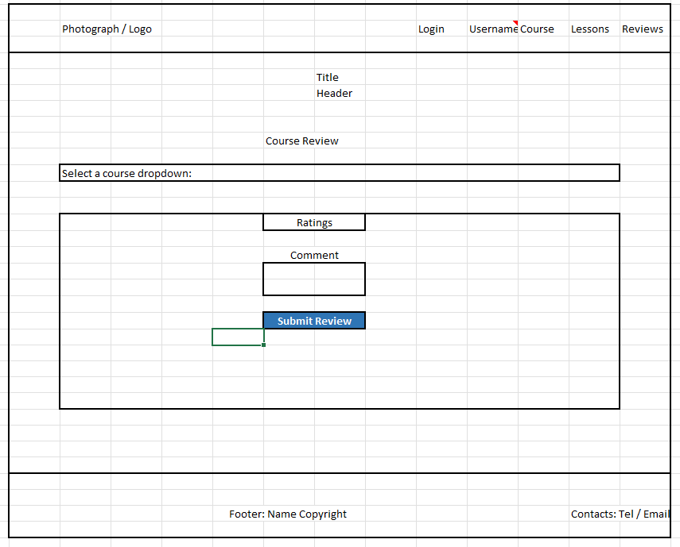
MAIN
LOGIN-SIGNUP
LESSONS
COURSES
REVIEWS

Slide 6
Project Components
The portal is coded with a React front-end, and a Node.js back-end
Main PAGES
Back End
LOGIN/Sign-Up
Landing page
Gallery
Courses page
Lessons
Reviews
Repository of learner details
Repository of instructor/admin details
Course details
Reviews
Lessons
The user can sign up and login to the main site
Details are carried through to all areas of the site

Slide 7
Timeline
Session 1
Explored initial concepts and developed the WireFrame for the front-end
Setting up the GitHub repo
Session 2
Coding on the back end, and the main home page
Darren’s beautiful Gallery of learner’s work
Session 3
Session 4
Fixing the log in/sign up front-to-back
Presentation drafting
Merge conflicts
Session 5B
Fixing a major bug in the courses page
Fixing the login/signup
Session 5A
An additional unofficial Zoom meeting: integrating all the code and ensuring the front and back end are fully communicating
Merge conflicts
LensEd – The Front-End Collective

Slide 8
Front-End Coding
Key Features
LensEd – The Front-End Collective

Slide 9
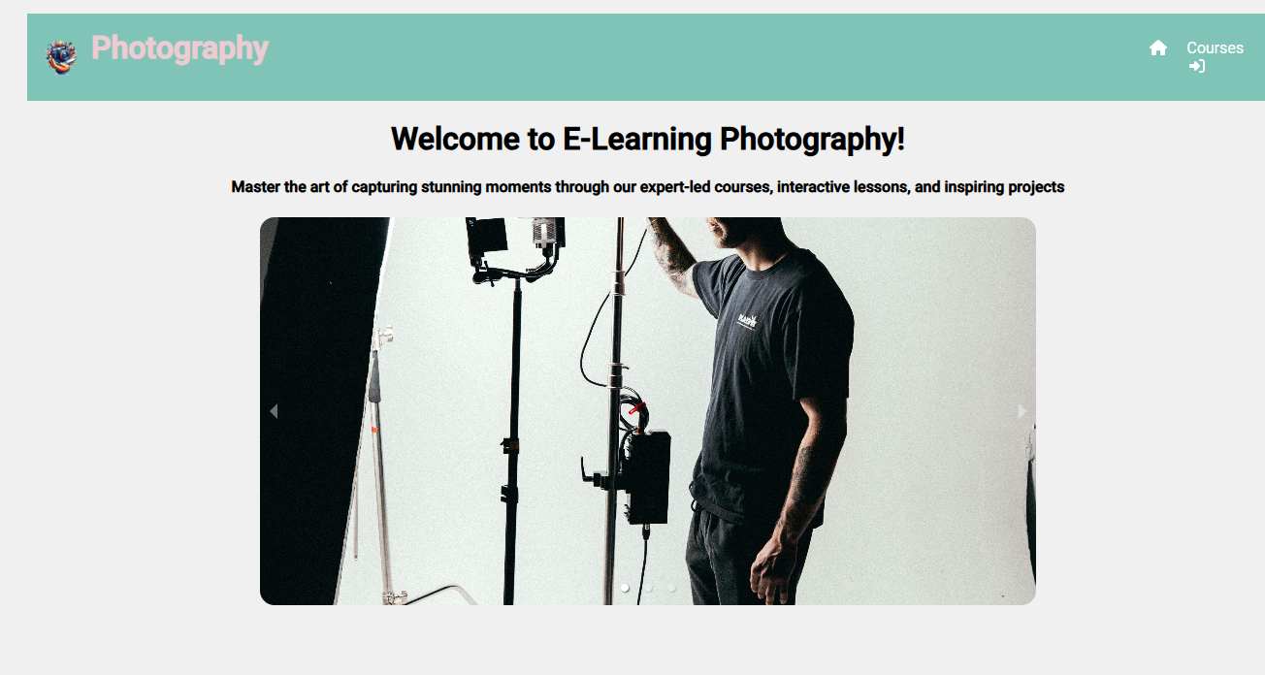
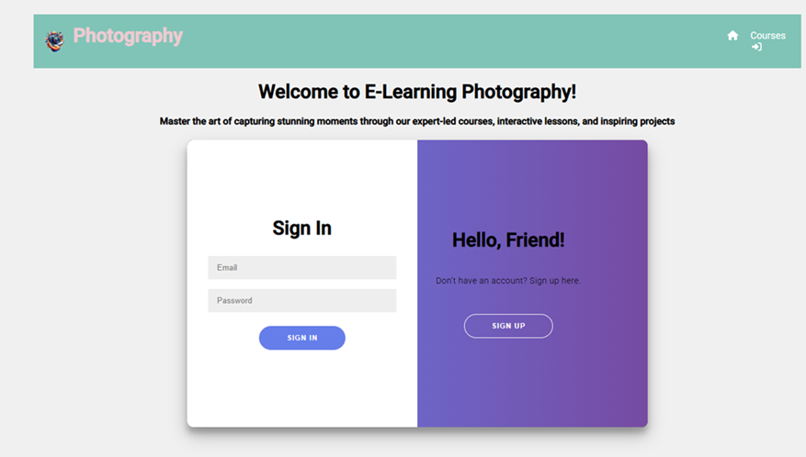
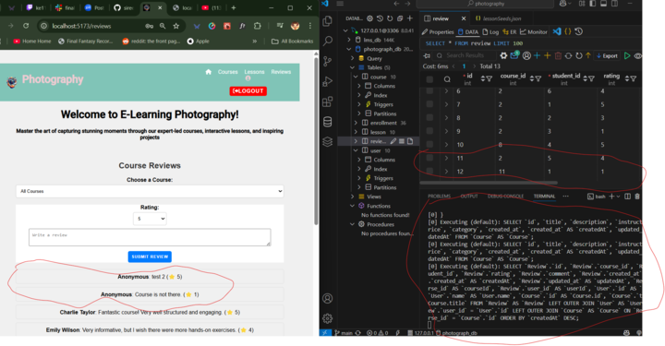
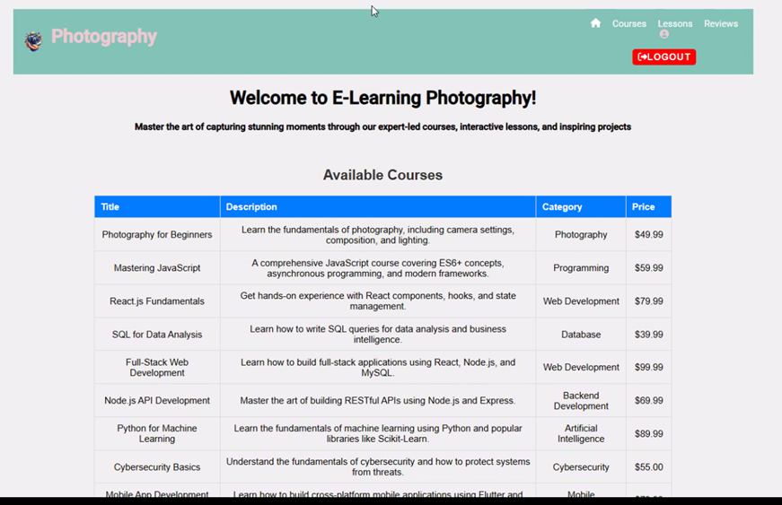
Carousel Gallery on the Main Page
Sign in transition
User Review and Ratings
Courses

Slide 10
Back-End coding
Key Features
LensEd – The Front End Collective

Slide 11

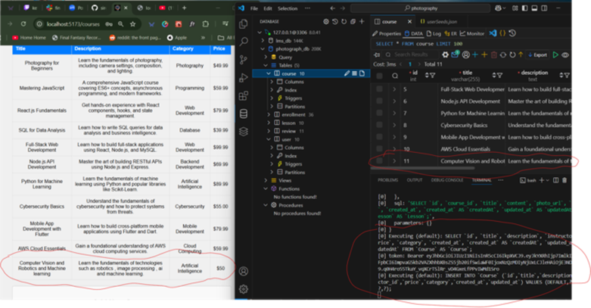

Slide 12
Combining to Full-Stack and Testing
LensEd – The Front-End Collective

Slide 13
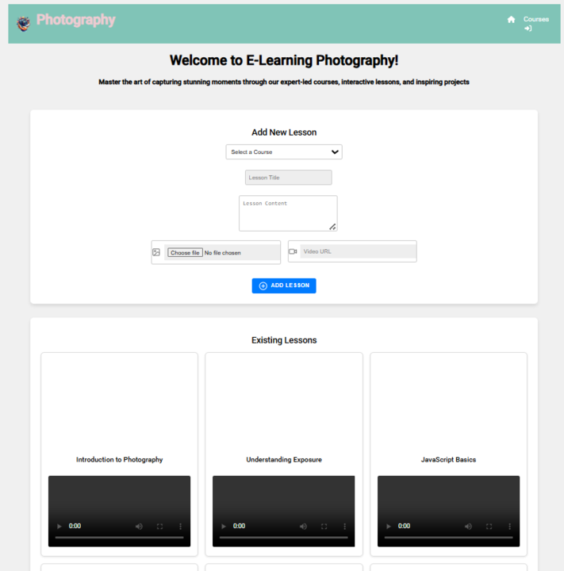
Fixing routes…
Login-sign up, transition overlap…
Final user testing: Lessons error bug
Solution: Back end data base was missing the photo URL. Used SQL code ALTER TABLE lessons ADD COLUMN photo_url VARCHAR(255) on the lessons table and reseeded

Slide 14
Documentation & Github
LensEd – The Front End Collective

Slide 15
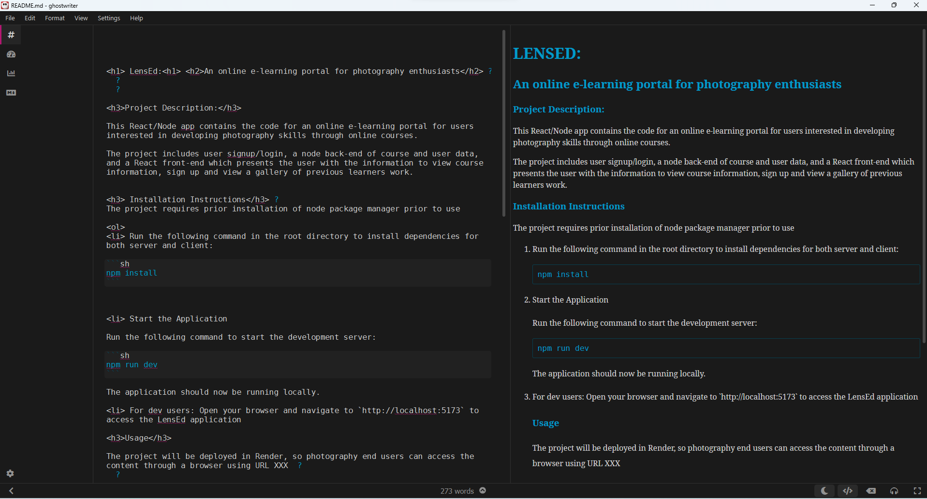
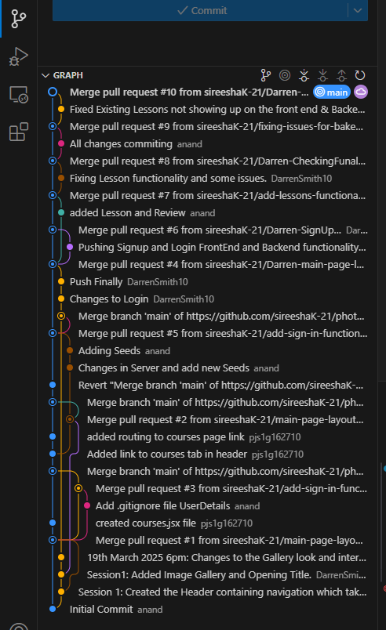
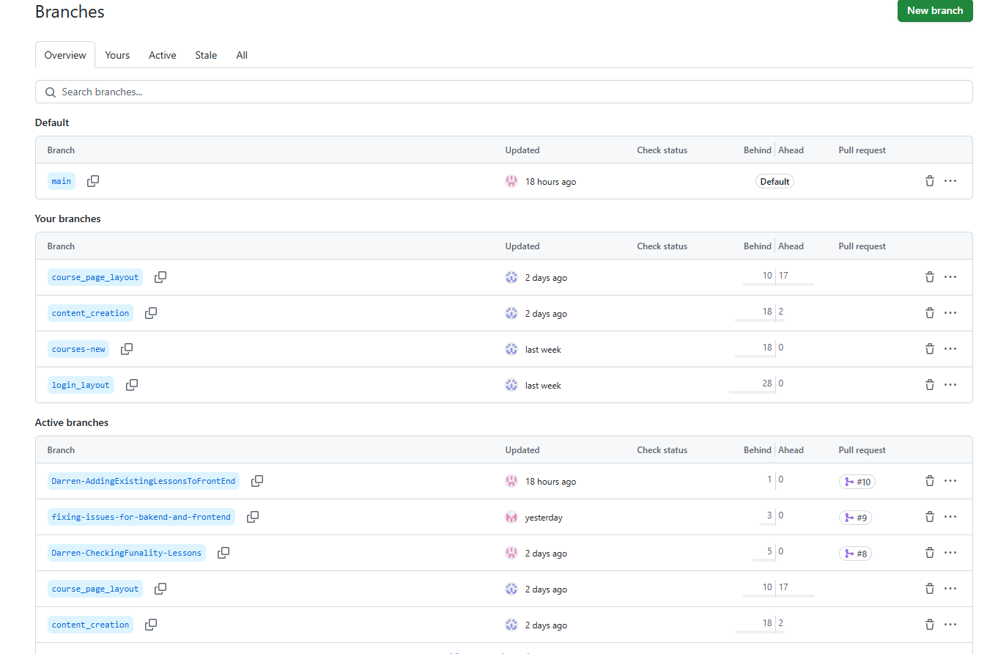
README file (Markdown, Ghostwriter
Collaborative working on branches in Git

Slide 16

Thank You
GitHub repo link:
https://github.com/sireeshaK-21/photography.git
LensEd – The Front-End Collective

